Slide 1
Relationships, Health and Sex Education at Tewin Cowper

Slide 2
What is Relationships and Sex Education?
Relationships Education in primary schools should teach the fundamental building blocks and characteristics of positive relationships, with particular reference to friendships, family relationships, and relationships with other peers and adults.
It is interwoven in our PSHE planning and teaching

Slide 3
What is Relationships and Sex Education?
At Tewin Cowper, we believe that children should learn about relationships as well as the emotional, social and physical aspects of growing up, human sexuality and sexual health in an age-appropriate way. This goes beyond learning about relationships, to include puberty, how a baby is conceived and born, body ownership, and safeguarding. Although we refer to our resources as our Relationship Education curriculum, they also include elements of Health Education as well as non-statutory sex education. Therefore we often refer to this as RSE: Relationships and Sex Education.

Slide 4
What is Relationships and Sex Education?
The resources we use help children and young people to be safe, healthy and happy, both as they grow, and in their future lives. These lessons help to meet safeguarding, and emotional wellbeing requirements, as well as ensuring that schools cover the requirements of the DfE RSHE guidance.

Slide 5
Department for Education statutory requirements…
From September 2020 it has been compulsory for schools to teach Relationships and Health Education
The DfE also strongly encourages primary schools to deliver sex education to help prepare children for their transition to secondary school

Slide 6
Most schools have already been delivering very effective Relationships and Sex Education for years and the new guidance is simply about ensuring that all children get the information they need and want.
The lessons will help children to learn about their bodies including the changes that take place at puberty, and will help keep them safe, so they can form healthy relationships (friendships) with others, now and in the future.

Slide 7

How we teach these lessons…
At Tewin Cowper, we are using the leading children’s health and wellbeing charity, Coram Life Education (CLE) to support us in meeting those legal requirements.
We do this in two ways:
- A visit from a trained educator who will deliver aspects of the Relationships Education and Health Education programme
- Using Coram Life Education’s online SCARF teaching resources

Slide 8
Why has the guidance been updated?
Risk of poor Mental Health
25% of girls start their periods whilst learning about them at school causing them to worry about why they are bleeding and how serious the cause might be
38% of boys experience wet dreams before having learnt about them, leaving them open to anxiety about a natural bodily function
Current government guidance states that children should learn about puberty before they experience it – which is why this subject becoming statutory in all schools is so important.

Slide 9
Protective Factors
RSE has a protective factor when it comes to safeguarding children. 1 in 20 children are sexually abused and 1 in 3 of these are not reported to an adult.
Sexual abuse can happen to any child; the best way to safeguard children is to ensure that they receive information on naming parts of their body, knowing the difference between appropriate and inappropriate touch, and having the skills and confidence to talk to a trusted adult to report any abuse.

Slide 10
Academic Benefits
Research shows that children with better health (including mental health) and wellbeing are likely to achieve better academically.
By learning about positive relationships, respect for themselves and others, and behaving appropriately and safely online, they are better able to enjoy their friendships and therefore focus more at school.

Slide 11
Concerns?
There is sometimes concern that RSE in school might promote sexual experimentation or cause confusion about an individual’s sexuality.
Research on quality Relationships and Sex Education in the UK by the National Survey of Sexual Attitudes and Lifestyles team consistently shows that men and women who reported that lessons at school were their main source of information about sex were more likely to have started having sex at a later age than those for whom parent or other sources were their main source.

Slide 12
Parental Support
We recognise that parents play a vital part in their child’s RSE, and we encourage you to discuss these themes with your child at home as well.
Parent letters are sent home in Years 4, 5 and 6 giving a list of what will be taught in Puberty lessons to enable conversations at home
We encourage children to ask questions

Slide 13
Coram Life Education
SCARF provide a curriculum and a whole-school framework for building the essential life skills to support physical and emotional well-being – crucial for children to achieve their best, academically and socially.
It meets all DfE requirements for statutory Relationships, Sex and Health Education

Slide 14
What will my child learn?
For each year group, there are six suggested themed units which provide a complete PSHE and wellbeing curriculum (this also covers Relationships and Sex Education)
These are all taught in an age appropriate and age relevant way

Slide 15
Me and My Relationships
Explores feelings and emotions, develops skills to manage conflict, helps identify our special people and equips children to recognise the qualities of healthy friendships and how to manage them.

Slide 16
Valuing Difference
Includes a strong focus on British Values, supports children to develop respectful relationships with others, recognise bullying and know their responsibilities as a bystander.

Slide 17
Keeping Myself Safe
Covers a number of safety aspects from statutory Relationships Education including being able to identify trusted adults in their lives, what to do when faced with a dilemma and recognising appropriate and inappropriate touch.

Slide 18
Rights and Responsibilities
Explores broader topics including looking after the environment, economic education and the changing rights and responsibilities children have as they grow older.

Slide 19
Being My Best
Includes a focus on keeping physically healthy, developing a growth mindset to facilitate resiliency, setting goals and ways to achieve them.

Slide 20
Growing and Changing
Has age-appropriate plans to cover the physical and emotional changes that happen as children as they grow older, including changes at puberty and how to approach this with confidence. Age-appropriate lessons on relationships and sex education are also included.

Slide 21
Age Appropriate and Relevant
4-5 Year Olds
Being the same and different, our special people, different families, different homes, our feelings, being unique and special, being kind, caring and friendly, keeping safe, keeping healthy, resilience, life stages and growing from young to old.

Slide 22
Age Appropriate and Relevant
5-6 Year Olds
Explores themes around families and their special people, the importance of respecting others including those that are different from us, recognising that genitals are private and their correct names; develop an understanding of the difference between surprises and secrets (good or bad secrets) and when not to keep bad adult secrets; helps develop judgement of what kind of physical contact is acceptable or unacceptable and how to respond to this (including who to tell and how to tell them).

Slide 23
Age Appropriate and Relevant
6-7 Year Olds
Looks at the process of growing from young to old and how people’s needs change; explores the opportunities and responsibilities that increasing independence can bring, recognising that they share a responsibility for keeping themselves and others safe.

Slide 24
Age Appropriate and Relevant
7-8 Year Olds
Introduces themes about change, including menstruation (Yr 4) and bereavement, healthy and unhealthy relationships (friendships), how images in the media do not always reflect reality and the impact of this on people’s thoughts and feelings; the nature and consequences of discrimination; the importance of protecting personal information online; understanding risk and building resilience; making informed choices; resisting pressure and recognising when and how to ask for help.

Slide 25
Age Appropriate and Relevant
8-9 Year Olds
Builds on the themes covered in previous years, looking more closely at body changes as they approach and move through puberty including: menstruation and human reproduction; conflicting emotions; what positively and negatively affects their physical, mental and emotional health; understanding good and not-so-good feelings; recognising and challenging stereotypes; consequences of their actions; pressures to behave in an unacceptable, unhealthy or risky way and that marriage is a commitment freely entered into by both people.

Slide 26
Age Appropriate and Relevant
9-10 Year Olds
Builds on the themes covered previously and in greater depth, looking more closely at: body changes and feelings during puberty; how their changing feelings can affect those they live with; what makes relationships unhealthy; exploring risky behaviour in more detail; different types of bullying including homophobic and transphobic; how to keep their personal information private online (and why this is important), and how to use social media safely.

Slide 27
Age Appropriate and Relevant
10-11 Year Olds
Builds on and reinforces all the themes of the previous years, with new content built into the lesson plans looking at: body image and the media; forced marriage; female genital mutilation (FGM); sexual intercourse; HIV; and managing pressure online.

Slide 28
Statutory and Non-Statutory Sex Education
Puberty, Reproduction and Birth are all Statutory and are taught within our RSE, PSHE and Science Curriculum
Non-Statutory – Conception - Year 6 ‘Making Babies’ Lesson

Slide 29
How to support at home…
If you feel it is time to talk to your child about growing up and the changes they are likely to experience it’s best to offer it in small chunks, rather than do it in one go, often known as ‘The Talk’. This gives children time to digest the new information and ask you further questions as they develop more understanding.
If your child asks you questions try to stay calm, and not worry if you don’t know the answer. There are plenty of websites that you can use together to help you find the answers to their questions in a factual, honest, age appropriate way (see details below for resources on our website).

Slide 30
How to support at home…
Use everyday opportunities to bring up the topic; things you see on TV or hear on the radio can be great conversation starters to talk about topics such as relationships, sex and body image. Reading books with your child is also a great way of introducing topics and helping children to understand themselves, their bodies and the world around them.
If you do have family names for genitals, ensure your child also knows their scientific names too. Nobody likes to think their child is at risk of abuse, but knowing the correct words for their genitals will help them report abuse if it did ever happen.

Slide 31
How to support at home…
By showing your child that you are comfortable with them asking you questions now, you are helping to develop a relationship with them where they can seek your advice and support in their adolescent years.
Visit the specially created Coram Life Education SCARF webpage for more information including a list of books and websites that will support both you and your child along with some activities you to support their learning.

Slide 32
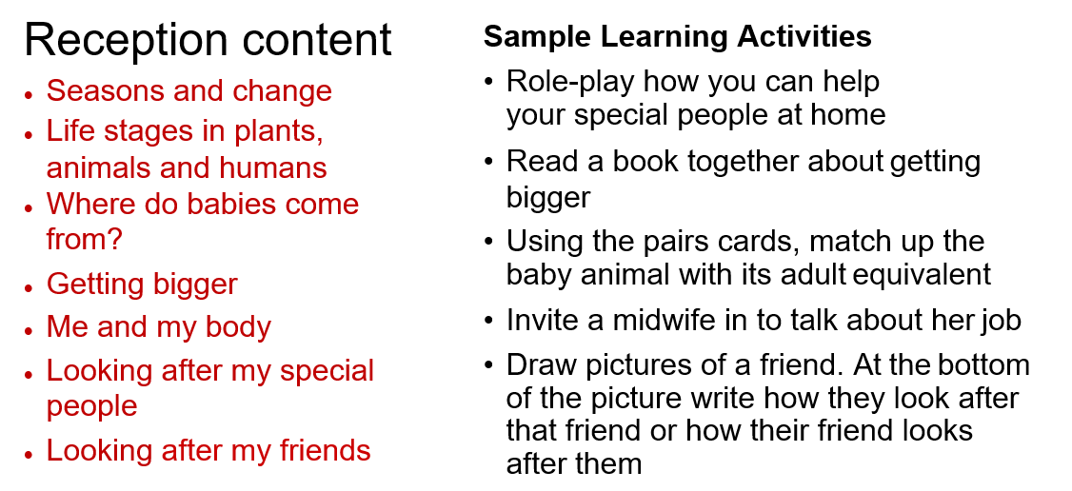
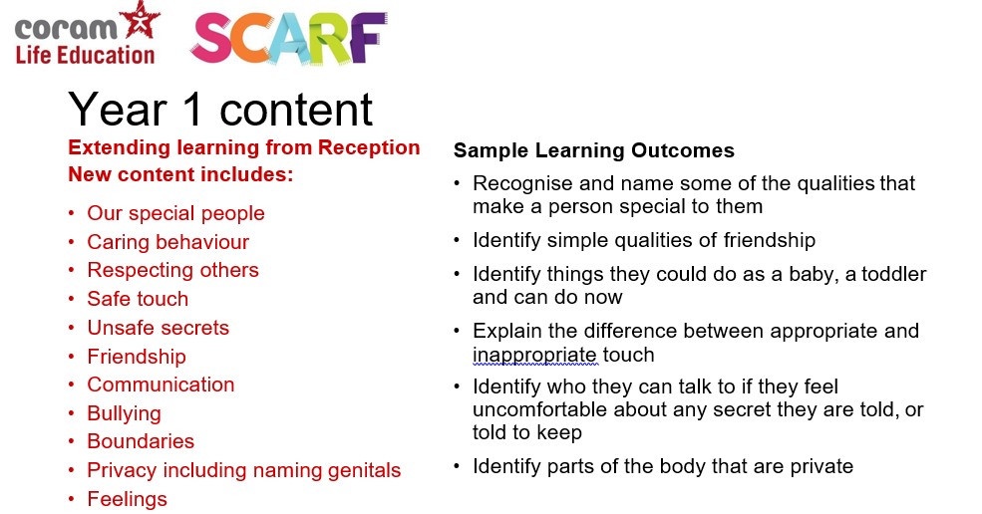
Any Questions?

